Slide 1
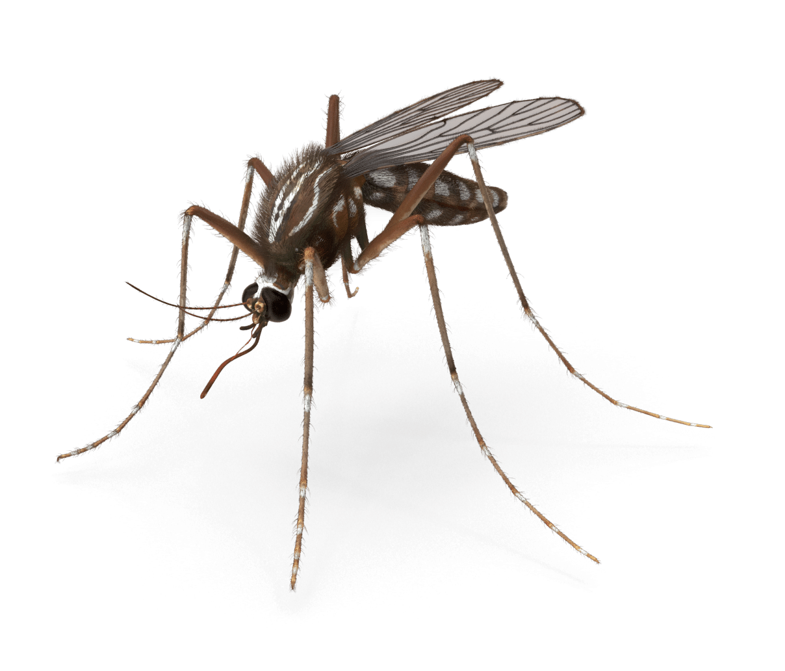
Reducing Malaria Incidence in Kenya
Leveraging Data-Driven Solutions for SDG 3: Good Health and Well-being
By Dionysius Ogero

Slide 2

Project Overview and SDG Alignment
SDG Focus: SDG 3 - Good Health and Well-being
Project Goal: My goal is to reduce the incidence of malaria in Kenya using data-driven insights.
Alignment:
- Target 3.3: End epidemics of malaria by reducing its incidence.
- I will use data to identify trends, optimize treatments, and allocate resources effectively.

Slide 3

Problem Definition and Significance
Problem Statement:
- Malaria continues to be a significant health challenge in Kenya.
- Effective intervention strategies based on reliable data are crucial.
Significance:
- Malaria is a leading cause of illness and death in many regions.
- Reducing its incidence will improve the quality of life and align with global health goals.

Slide 4
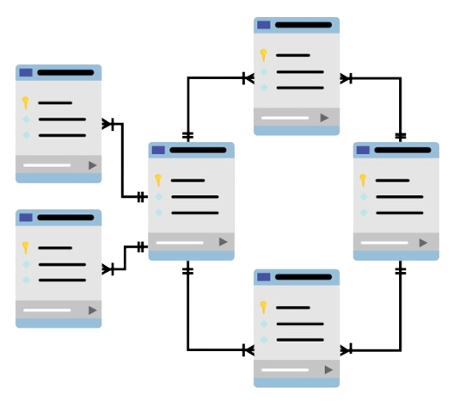
Database Design and Schema
ERD Overview:
Entities: Patients, Hospitals, Treatments, Diseases, Regions.
Relationships: I designed the system so that patients receive
treatments for diseases at hospitals in specific regions.
Schema Details:
- Each table's primary keys and foreign key relationships ensure data integrity.
- The schema is optimized to facilitate easy data retrieval and analysis.

Slide 5

Sample Data and Insights
Sample Data:
- I created example entries for patients, hospitals, treatments, and
diseases to demonstrate how data is stored and linked in the database.
Data Consistency:
- I ensured consistency through referential integrity checks and validation rules.
Use Case:
- For instance, I can track a patient's treatment history across different hospitals and regions.

Slide 6
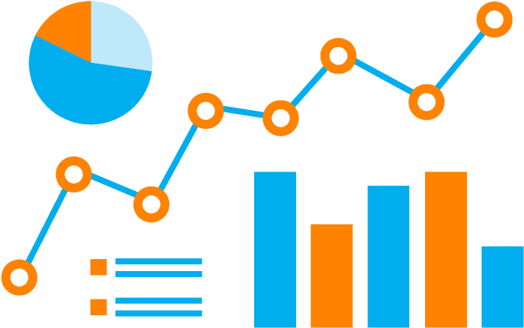
Data Analysis Insights
Common Diseases:
-Top Disease: Malaria, based on frequency of occurrence in the dataset.
Treatment Effectiveness:
Most Used Treatment: Treatment A, which appears many times in the data.
- This provides insight into the most frequently administered treatments.
Regional Distribution
- Hotspots: I identified regions with higher malaria incidence, which can help target interventions more effectively.

Slide 7
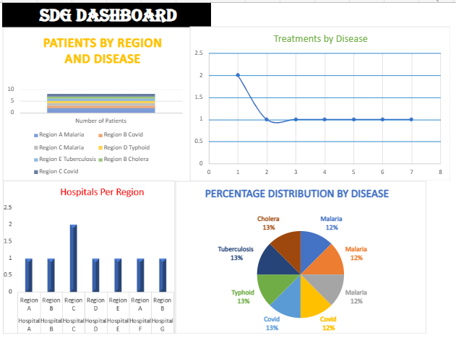
Excel Dashboard Demonstration
Dashboard Overview:
I developed an interactive dashboard in Excel that visualizes key metrics,
such as disease occurrence, treatment effectiveness, and regional distribution.
Screenshots:
Here is the screenshot of the most
insightful graphs and tables
from the dashboard.
Functionality:
- The dashboard includes filters and pivot tables, allowing for dynamic data exploration.

Slide 8
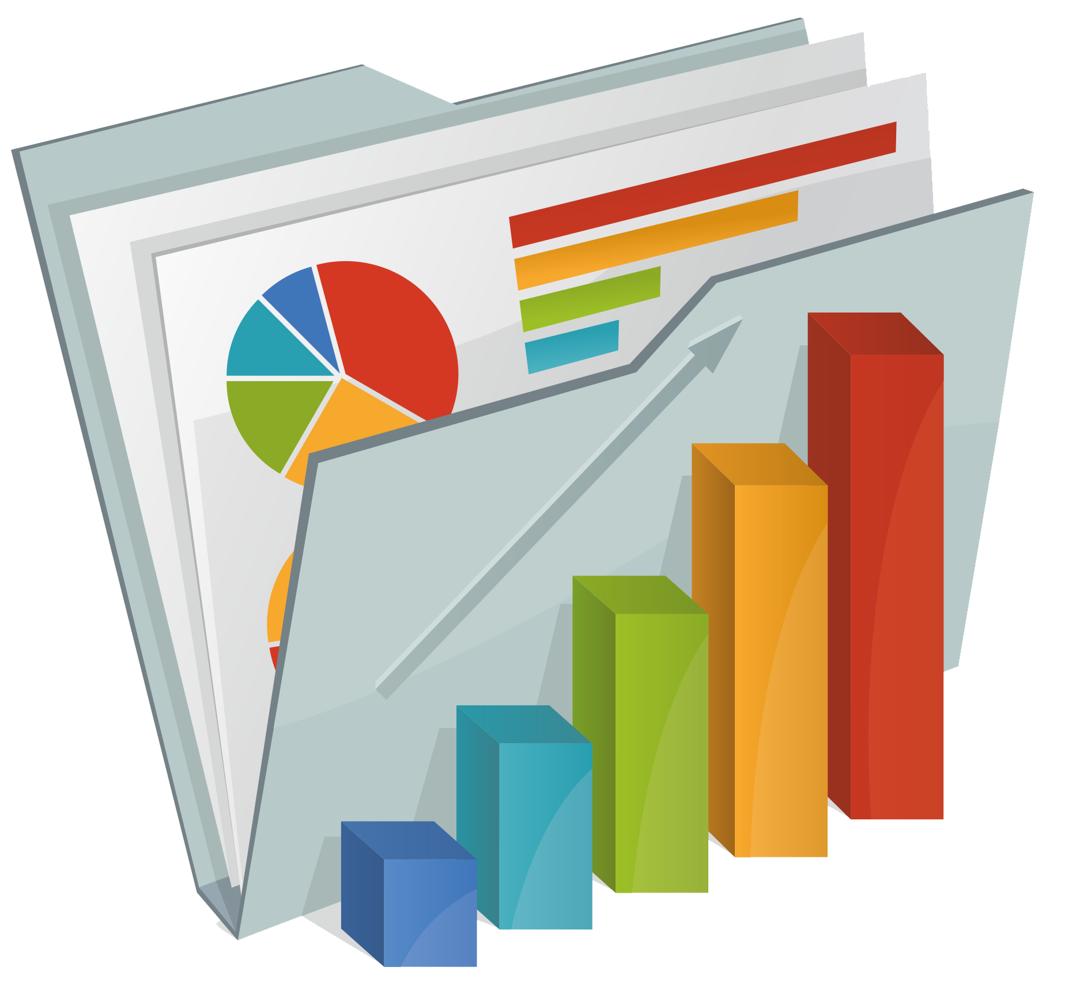
Implementation and Integration
Data Pipeline:
- I integrated the SQL database with Excel, enabling seamless data transfer and analysis.
- The dashboard automatically updates to reflect the latest data insights.
Technical Overview:
- I used SQL queries to extract data, Excel formulas for consistency checks, and charts for visualization.
User-Friendly Interface:
- The dashboard is designed to be easily accessible to healthcare professionals and decision-makers, regardless of their technical background.

Slide 9

Impact and Future Work
-Current Impact:
The project has already contributed to improved decision-making in resource allocation and treatment optimization.
- I believe that data-driven strategies can lead to a measurable reduction in malaria
cases.
Future Work:
- I plan to expand the database to include more regions and disease types.
Integrating predictive analytics will allow for better forecasting of malaria outbreaks.
- I am also looking to collaborate with local health authorities for broader implementation.

Slide 10
Conclusion and Call to Action
Summary:
- This data-driven approach to reducing malaria aligns with SDG 3 and has the potential to make a significant impact.
- The project's success so far demonstrates its potential for wider application.
Call to Action:
- I encourage you to support the expansion of this initiative to other regions.
- Further investment in research and development will lead to even greater health outcomes.

Slide 11
THANK YOU
CONTACT ME : dionysiusdionz19@gmail.com

